Slide 1
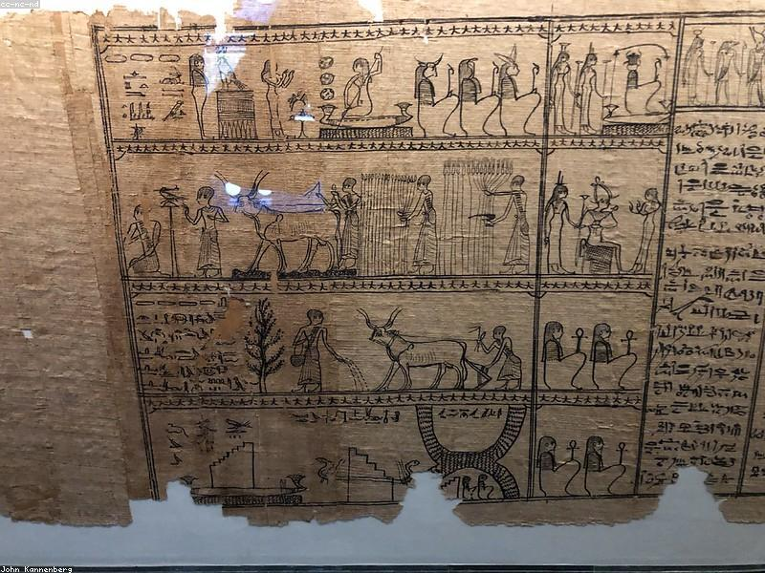
Definition of an Essay
- An essay is a short piece of writing on a particular subject.
- Essays are used to express ideas, arguments, and opinions.

Slide 2

Types of Essays
- There are several types of essays, including narrative, descriptive, expository, and persuasive.
- Each type serves a different purpose and audience.

Slide 3
Structure of an Essay
- A typical essay consists of an introduction, body paragraphs, and a conclusion.
- The introduction presents the main idea, while the body elaborates on it, and the conclusion summarizes the key points.

Slide 4

Importance of Essays
- Essays are crucial in education as they help develop critical thinking and writing skills.
- They also serve as a means of communication and expression.

Slide 5
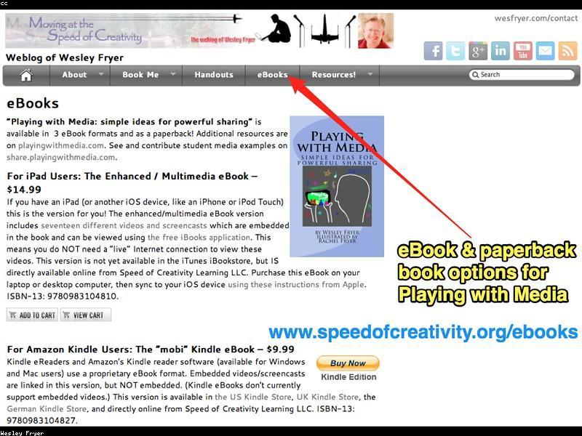
Tips for Writing an Essay
- Start with a clear thesis statement to guide your writing.
- Organize your thoughts logically and use transitions for flow.
- Revise and proofread to ensure clarity and correctness.

